Slide 1

CP 230 Motion Planning for Autonomous Systems
Assignment – 6 (Group Work)
Teaching Assistants:
Samiksha R. Nagrare
Ajay Kumar Sandula
Mukund Maitra
Ishfaq Zahoor Bhat
Course Instructors:
Dr. Debasish Ghose
Dr. Pradipta Biswas

Slide 2
Evaluation Questions and Marks (30)
Part A: Do it with a point mass 9 Marks
Part B: Do it with the given robot polygon 21 Marks
What are your observations by changing the number of nodes? How many edges were constructed for respective ‘nnodes’ for Part-A and Part-B?
How do you approach growing CO (configuration space of obstacles) space and configuration-space boundary for Part-B?
What are your observations on grown convex obstacles and non-convex obstacles Part-B?
For a configuration space with triangular boundary, what is your approach to generate nodes?
You are free to choose the following:
Reference Point on the robot

Slide 3
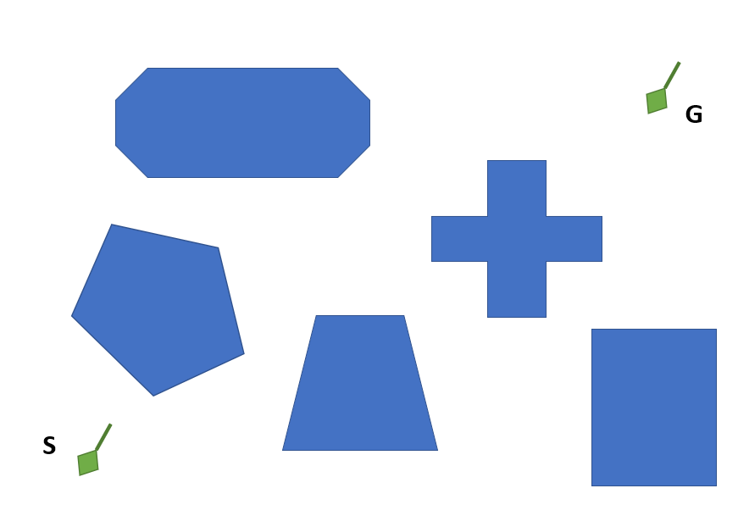
Questions
1, 2
0
2
4
6
8
10
12
14
16
0
2
4
6
8
10
12
14
16
18
20

Slide 4
Questions
3, 4
G
0
2
4
6
8
10
12
14
16
S
0
2
4
6
8
10
12
14
16
18
20

Slide 5
G
Questions
5, 6
0
2
4
6
8
10
12
14
16
S
0
2
4
6
8
10
12
14
16
18
20

Slide 6
Questions
7, 8
G
0
2
4
6
8
10
12
14
16
S
0
2
4
6
8
10
12
14
16
18
20
22

Slide 7
Questions
9, 10
0
2
4
6
8
10
12
14
16
G
S
0
2
4
6
8
10
12
14
16
18
20

